Slide 1
Trumping the Multicore Memory Hierarchy with Hi-Spade
Phillip B. Gibbons
Intel Labs Pittsburgh
September 22, 2011

Slide 2
Abstract
The goal of the Hi-Spade project is to enable a hierarchy-savvy approach to algorithm design and systems for emerging parallel hierarchies. Good performance often requires effective use of the cache/memory/storage hierarchy of the target computing platform. Two recent trends---pervasive multi-cores and pervasive flash-based SSDs---provide both new challenges and new opportunities for maximizing performance. The project seeks to create abstractions, tools and techniques that (i) assist programmers and algorithm designers in achieving effective use of emerging hierarchies and (ii) leads to systems that better leverage the new capabilities these hierarchies provide. Our abstractions seek a sweet spot that exposes only what must be exposed for high performance, while our techniques deliver that good performance across a variety of platforms and platform-sharing scenarios. Key enablers of our approach include internally-deterministic parallel programming, new cache abstractions, novel thread schedulers, and effective use of available flash devices (and other NVM technologies such as phase change memory). Our performance evaluations consider a variety of application kernels involving sorting, graphs, geometry, graphics, string processing, and database operations.
(hidden slide)
Notes:
Hidden Slide

Slide 3
For Good Performance, Must Use the Hierarchy Effectively
CPU
Performance:
Running/response time
Throughput
Power
Hierarchy:
L1
Cache
L2 Cache
Main Memory
Memory
Storage
Magnetic Disks

Slide 4
Clear Trend: Hierarchy Getting Richer
More levels of cache
Pervasive Multicore
New memory / storage technologies
E.g., pervasive use of Flash, emerging use of PCM
These emerging hierarchies bring both new challenges & new opportunities

Slide 5
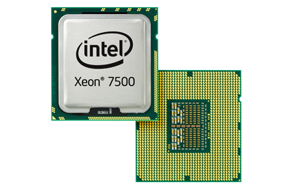
E.g., Xeon 7500 Series MP Platform
socket
socket
2 HW threads
2 HW threads
2 HW threads
2 HW threads
8 …
8 …
32KB
32KB
4 …
32KB
32KB
256KB
256KB
256KB
256KB
24MB Shared L3 Cache
24MB Shared L3 Cache
up to 1 TB Main Memory
Attach: Magnetic Disks & Flash Devices
Notes:
32KB L1 Instruction caches not shown
Nehalem-EX, up to 2.66 GHz, 45nm
4 sockets with one-hop interconnect. 32 cores / 64 hardware threads
Up to 256 sockets / server (but then not all one-hop)

Slide 6
How Hierarchy is Treated Today
Algorithm Designers & Application/System Developers tend towards one of two extremes
(Pain)-Fully
Aware
Ignorant
API view: Memory + I/O;
Parallelism often ignored
Performance iffy
Hand-tuned to platform
Effort high, Not portable, Limited sharing scenarios
Or they focus on one or a few aspects, but without a comprehensive view of the whole

Slide 7
Hi-Spade: Outline / Key Take-aways
Hierarchies are important but challenging
Hi-Spade vision: Hierarchy-savvy algorithms & systems
Smart thread schedulers enable simple, hierarchy-savvy abstractions
Flash-savvy (database) systems maximize benefits of Flash devices
Ongoing work w/ many open problems

Slide 8
Hierarchy-Savvy parallel algorithm design (Hi-Spade) project
…seeks to enable:
A hierarchy-savvy approach to algorithm design & systems for emerging parallel hierarchies
Focus on what must be exposed for good performance
Sweet-spot between ignorant and (pain)fully aware
Robust across many platforms & resource sharing scenarios
“Hierarchy-Savvy”
http://www.pittsburgh.intel-research.net/projects/hi-spade/
Notes:
http://www.pittsburgh.intel-research.net/projects/hi-spade/

Slide 9
Hierarchy-Savvy Sweet Spot
Platform 1
Hierarchy-Savvy
(Pain)-Fully
Aware
performance
Platform 2
Ignorant
programming effort
Modest effort, good performance, robust

Slide 10
Hi-Spade Research Scope
A hierarchy-savvy approach to algorithm design & systems for emerging parallel hierarchies
Agenda: Create abstractions, tools & techniques that
Assist programmers & algorithm designers in achieving effective use of emerging hierarchies
Lead to systems that better leverage the new capabilities these hierarchies provide
Theory / Systems / Applications

Slide 11
Focus 1: Irregular Algorithms
Sequences and strings: Sorting, Suffix arrays, Seq. alignment
Graph algorithms: Min spanning tree, BFS, coloring, separators
Machine learning: Sparse SVM, K-means, Gibbs sampling, LASSO
Graphics: Ray tracing, Micropoly rendering
Geometry: Delaunay triangulation, Nearest neighbors, N-body
Compared to well-studied regular algorithms:
Harder to find effective parallelism
Harder to exploit memory hierarchy
Focus 2: Database Systems

Slide 12
Hi-Spade: Summary of Results
Smart thread schedulers can enable simple, hierarchy-savvy abstractions
PDF scheduler for shared caches [SPAA’04]
Scheduling for constructive sharing [SPAA’07]
Controlled-PDF scheduler [SODA’08]
Work stealing overheads beyond fork-join [SPAA’09]
Hierarchy-savvy parallel algorithms [SPAA’10]
Parallel cache-oblivious model & scheduler [SPAA’11]
Tools, Hooks, Determinism simplifies programming
Memory-block transactions [SPAA’08]
Semantic space profiling /visualization [ICFP’08, JFP2010]
Efficient internal determinism [submitted]
Notes:
1) G.E. Blelloch and P.B. Gibbons, ACM Symposium on Parallelism in Algorithms and Architectures (SPAA), 2004.
2) S. Chen, P. B. Gibbons, M. Kozuch, V. Liaskovitis, A. Ailamaki, G. E. Blelloch, B. Falsafi, L. Fix, N.
Hardavellas, T. C. Mowry and C. Wilkerson, SPAA, 2007.
3) G. E. Blelloch, R. A. Chowdhury, P. B. Gibbons, V. Ramachandran, S. Chen and M. Kozuch, ACM-SIAM Symposium on Discrete Algorithms, 2008
4) D. Spoonhower, G. E. Blelloch, P. B. Gibbons and R. Harper, SPAA, 2009
5) G. E. Blelloch, P. B. Gibbons and H. V. Simhadri, SPAA, 2010
6) G. E. Blelloch, J. Fineman, P. B. Gibbons and H. V. Simhadri, submitted
1) G. E. Blelloch, P. B. Gibbons and H. V. Simhadri, SPAA, 2008
2) D. Spoonhower, G. E. Blelloch, R. Harper and P. B. Gibbons, ACM International Conference on Functional Programming, 2008, Journal of Functional Programming, 2010
7) G. E. Blelloch, P. B. Gibbons and H. V. Simhadri, SPAA, 2010.

Slide 13
Hi-Spade: Summary of Results
Flash-savvy (database) systems maximize benefits of Flash devices
Flash-savvy algorithms [VLDB’08, PVLDB 2010]
Flash-based OLTP transactional logging [SIGMOD’09]
Non-blocking joins for Data Warehouses [SIGMOD’10]
Efficient online updates for Data Warehouses [SIGMOD’11]
Phase Change Memory-savvy (database) systems maximize benefits of PCM
PCM-savvy database algorithms [CIDR’11]
Notes:
1) S. Nath and P. B. Gibbons, The VLDB Journal, 19(1), 2010. Preliminary version in VLDB 2008.
2) S. Chen, Sigmod Conference, 2009.
3) S. Chen, P. B. Gibbons, S. Nath, Sigmod Conference, 2010.
4) M. Athanassoulis, S. Chen, A. Ailamaki, P. B. Gibbons, R. Stoika, submitted
5) S. Chen, P. B. Gibbons, S. Nath, to appear in CIDR’11

Slide 14
Hi-Spade: Outline / Key Take-aways
Hierarchies are important but challenging
Hi-Spade vision: Hierarchy-savvy algorithms & systems
Smart thread schedulers enable simple, hierarchy-savvy abstractions
Flash-savvy (database) systems maximize benefits of Flash devices
Ongoing work w/ many open problems

Slide 15
Abstract Hierarchy: Target Platform
Specific
Example:
Xeon 7500
…
…
…
General Abstraction: Tree of Caches
…
…
…
…
…
…
…
…
…
…
…
…
…
…
…
…
…
…
…
…
…
…
…
Notes:
The general abstraction captures the class of platforms we target. Although the picture shows a symmetric tree, the tree-of-caches abstraction includes asymmetric trees.

Slide 16
Abstract Hierarchy: Simplified View
What yields good hierarchy performance?
Spatial locality: use what’s brought in
Popular sizes: Cache lines 64B; Pages 4KB
Temporal locality: reuse it
Constructive sharing: don’t step on others’ toes
How might one simplify the view?
Approach 1: Design to a 2 or 3 level hierarchy (?)
Approach 2: Design to a sequential hierarchy (?)
Approach 3: Do both (??)

Slide 17
Sequential Hierarchies: Simplified View
External Memory Model
See [J.S. Vitter, ACM Computing Surveys, 2001]
Main Memory (size M)
Simple model
Minimize I/Os
Only 2 levels
Only 1 “cache”
Block size B
External Memory
External Memory Model
Can be good choice if bottleneck is last level
Notes:
Jeffrey S. Vitter, ACM Computing Surveys, 2001

Slide 18
Sequential Hierarchies: Simplified View
Cache-Oblivious Model [Frigo et al., FOCS’99]
Main Memory (size M)
Twist on EM Model: M & B unknown to Algorithm
simple model
Block size B
External Memory
Ideal Cache Model
Key Algorithm Goal: Good performance for any M & B
Key Goal Guaranteed good cache performance at all levels of hierarchy
Single CPU only (All caches shared)
Encourages Hierarchical Locality
Notes:
Matteo Frigo, Charles E. Leiserson, Harald Prokop, Sridhar Ramachandran, IEEE FOCS’99

Slide 19
Example Paradigms Achieving Key Goal
Scan: e.g., computing the sum of N items
N/B misses, for any B (optimal)
Divide-and-Conquer: e.g., matrix multiply C=A*B
A11*B11
+
A12*B21
A11*B12
+
A12*B22
A11
A12
B11
B12
=
*
A21*B11
+
A22*B21
A21*B12
+
A22*B22
A21
A22
B21
B22
Divide: Recursively compute A11*B11,…, A22*B22
Conquer: Compute 4 quadrant sums
Uses
Recursive Z-order Layout
2
3
O(N /B + N /(B*√M)) misses (optimal)
Notes:
M ≥ 3B
Z-ordering layout

Slide 20
Multicore Hierarchies: Possible Views
Design to Tree-of-Caches abstraction:
Multi-BSP Model [L.G. Valiant, ESA’08]
4 parameters/level: cache size, fanout, latency/sync cost, transfer bandwidth
Bulk-Synchronous
Our Goal:
~ Simplicity of Cache-Oblivious Model
Hierarchy-Savvy sweet spot
Do not require bulk-synchrony
…
…
…
…
…
…
…
…
…
…
…
Notes:
Leslie G. Valiant, European Symposium on Algorithms, 2008.

Slide 21
Multicore Hierarchies: Key Challenge
Theory underlying Ideal Cache Model falls apart once introduce parallelism:
Good performance for any M & B on 2 levels DOES NOT imply good performance at all levels of hierarchy
Key reason: Caches not fully shared
Key reason: Caches not fully shared
CPU1
CPU2
CPU3
What’s good for CPU1 is often bad for CPU2 & CPU3
e.g., all want to write B at ≈ the same time
L1
L1
L1
B
Shared L2 Cache
L2 Cache

Slide 22
Multicore Hierarchies Key New Dimension: Scheduling
Key new dimension: Scheduling of parallel threads
Has LARGE impact on cache performance
Recall our problem scenario:
all CPUs want to write B at ≈ the same time
Key reason: Caches not fully shared
CPU1
CPU2
CPU3
L1
L1
L1
B
Can mitigate (but not solve)
if can schedule the writes to be far apart in time
Shared L2 Cache
L2 Cache

Slide 23
Key Enabler: Fine-Grained Threading
Coarse Threading popular for decades
Spawn one thread per core at program initialization
Heavy-weight O.S. threads
E.g., Splash Benchmark
Better Alternative:
System supports user-level light-weight threads
Programs expose lots of parallelism
Dynamic parallelism: forking can be data-dependent
Smart runtime scheduler maps threads to cores, dynamically as computation proceeds
e.g., Cilk++, Intel TBB, OpenMP, MS Parallel Task Library

Slide 24
Cache Uses Among Multiple Threads
Destructive
compete for the limited on-chip cache
Constructive
share a largely overlapping working set
P
P
P
P
P
P
L1
L1
L1
L1
L1
L1
Interconnect
Interconnect
Shared L2 Cache
Shared L2 Cache
“Flood” off-chip PINs
Notes:
Slides thanks to Shimin Chen

Slide 25
Smart Thread Schedulers
Work Stealing
Give priority to tasks in local work queue
Good for private caches
Parallel Depth-first (PDF) [JACM’99, SPAA’04]
Give priority to earliest ready tasks in the sequential schedule
Good for shared caches
P
Sequential locality
to parallel locality
P
P
P
P
L1
L1
L1
L1
L1
L2 Cache
Shared L2 Cache
Main Memory
Main Memory
Notes:
G.E. Blelloch, P.B. Gibbons, Y. Matias, Journal of the ACM, 1999.
G.E. Blelloch, P.B. Gibbons, ACM Symposium on Parallelism in Algorithms and Architectures, 2004.

Slide 26
Parallel Merge Sort: WS vs. PDF
Work Stealing (WS):
8 cores
Parallel Depth First (PDF):
Cache miss
Cache hit
Mixed
Shared cache = 0.5 *(src array size + dest array size).

Slide 27
Low-Span + Cache-Oblivious Model
Observation: Guarantees on cache performance depend on the computation’s span S (length of critical path)
E.g., Work-stealing on single level of private caches: Thrm: For any computation w/ fork-join parallelism, O(M P S / B) more misses on P cores than on 1 core
Approach: Design parallel algorithms with
Low span, and
Good performance on Cache-Oblivious Model
[SPAA’10]
Thrm: For any computation w/ fork-join parallelism for each level i, only O(M P S / B ) more misses than on 1 core, for hierarchy of private caches
i
i
Low span S Good miss bound
Notes:
U. A. Acar, G. E. Blelloch and R. D. Blumofe, Theory of Computing Systems, 2002.
G. E. Blelloch, P. B. Gibbons and H. V. Simhadri, ACM Symposium on Parallelism in Algorithms and Architectures, 2010.

Slide 28
BT-Sort: New Variant of Sample Sort
[SPAA’10, another submitted]
 | weight | STL Sort | Sanders Sort | Quicksort | BT-Sort | BT-Sort
Cores |  | 1 | 32 | 32 | 32 | 1
Uniform | .1 | 15.8 | 1.06 | 4.22 | .82 | 20.2
Exponential | .1 | 10.8 | .79 | 2.49 | .53 | 13.8
Almost Sorted | .1 | 3.28 | 1.11 | 1.76 | .27 | 5.67
Trigram Strings | .2 | 58.2 | 4.63 | 8.6 | 1.05 | 30.8
Strings Permuted | .2 | 82.5 | 7.08 | 28.4 | 1.76 | 49.3
Structure | .3 | 17.6 | 2.03 | 6.73 | 1.18 | 26.7
Average |  | 36.4 | 3.24 | 10.3 | 1.08 | 28.0
Time in seconds on 32 core Nehalem (4 X x7560)
All inputs are 100,000,000 long
All code written run on Cilk++ (also tested in Cilk+)
BT-Sort follows Low-Span + Cache-Oblivious approach

Slide 29
Handling the Tree-of-Caches
Guarantees of the “Low-depth” approach fail to hold for general tree-of-caches
To obtain guarantees for general tree-of-caches:
We define a Parallel Cache-Oblivious Model
and a corresponding Space-Bounded Scheduler
[SPAA’11]

Slide 30
Parallel Cache Oblivious Model
Differs from cache-oblivious model in how cache state is carried forward
Assuming this task fits in cache
Carry forward cache state according to some sequential order
All three subtasks start with same state
Memory
M,B
Merge state and carry forward
P

Slide 31
Parallel Cache-Oblivious Model
Differs from cache-oblivious model in how cache state is carried forward
Task does not fit in cache
All three tasks start with empty state
Memory
M,B
Strand starts with empty state
P
Leads to desired guarantees on Tree-of-Caches
Notes:
Spend more time on second case

Slide 32
Speed-ups on 32-core Nehalem
All algorithms are Internally-Deterministic

Slide 33
Hi-Spade: Outline / Key Take-aways
Hierarchies are important but challenging
Hi-Spade vision: Hierarchy-savvy algorithms & systems
Smart thread schedulers enable simple, hierarchy-savvy abstractions
Flash-savvy (database) systems maximize benefits of Flash devices
Ongoing work w/ many open problems

Slide 34
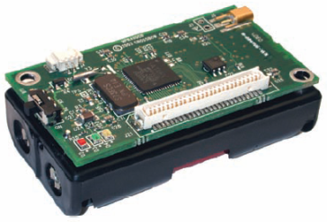
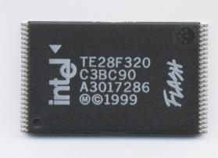
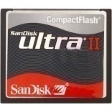
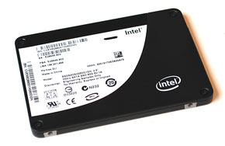
Flash Superior to Magnetic Disk on Many Metrics
Energy-efficient
Smaller
Lighter
More durable
Higher throughput
Less cooling cost

Slide 35
Flash-Savvy Systems
Simply replacing some magnetic disks with Flash devices WILL improve performance
However:
Much of the performance left on the table
Systems not tuned to Flash characteristics
Flash-savvy systems:
Maximize benefits of platform’s flash devices
What is best offloaded to flash?

Slide 36
NAND Flash Chip Properties
Block (64-128 pages)
Page (512-2048 B)
Read/write pages, erase blocks
…
…
Write page once after a block is erased
In-place update
1. Copy
2. Erase
3. Write
4. Copy
5. Erase
Random
Expensive operations:
In-place updates
Random writes
Sequential
Random
Sequential
0.4ms
0.6ms
0.4ms
127ms
Read
Write
Notes:
36

Slide 37
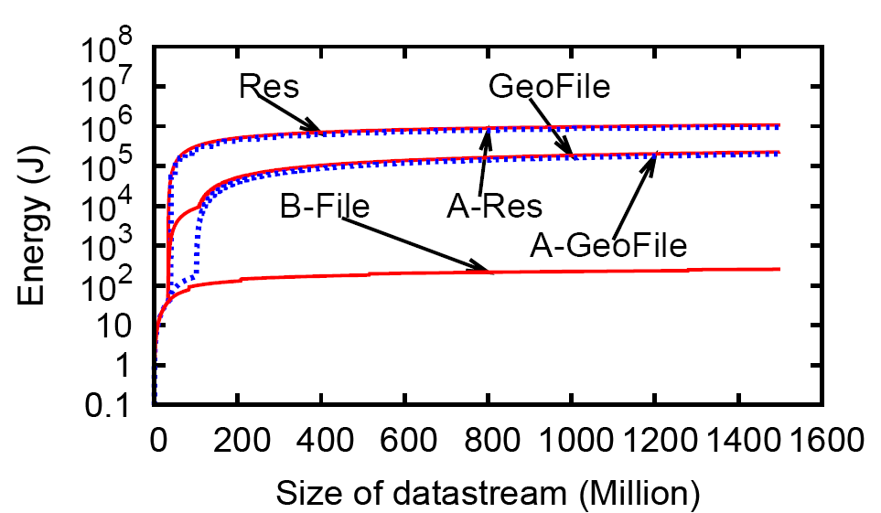
Energy to Maintain Random Sample
Using “Semi-Random” Writes in place of Random Writes
Our algorithm
Our Algorithm
[VLDB’08]
On Lexar CF card
Notes:
S. Nath and P. B. Gibbons, The VLDB Journal, 19(1), 2010. Preliminary version in VLDB 2008.

Slide 38
Quirks of Flash (Mostly) Hidden by SSD Firmware
Intel X25-M SSD
Random writes & in-place updates no longer slow

Slide 39
Flash Logging
Transactional logging: major bottleneck
Today, OLTP Databases can fit into main memory (e.g., in TPCC, 30M customers < 100GB)
In contrast, must flush redo log to stable media at commit time
Log access pattern: small sequential writes
Ill-suited for magnetic disks: incur full rotational delays
Our solution: FlashLogging using USB devices
Unconventional array design
Outlier detection & hiding
Efficient recovery
[SIGMOD’09]
Notes:
S. Chen, Sigmod Conference, 2009.

Slide 40
Flash Logging
Up to 5.7X improvements over disk based logging
Up to 98% of ideal performance
Multiple USB flash drives achieve better performance than a single SSD, at fraction of the price
Notes:
Implemented in MySQL-InnoDB
1 hour TPCC runs
Write cache disabled in logging devices:
disk: 1 disk
ssd: 1 SSD
usb: 2 flash drives + archival disk

Slide 41
PR-Join for Online Aggregation
Data warehouse and business intelligence
Fast growing multi-billion dollar market
Interactive ad-hoc queries
Important for detecting new trends
Fast response times hard to achieve
One promising approach: Online aggregation
Provides early representative results for aggregate queries (sum, avg, etc), i.e., estimates & statistical confidence intervals
Problem: Queries with joins are too slow
Our goal: A faster join for online aggregation

Slide 42
Design Space
High
PR-Join targets
Early Representative Result Rate
Ripple
SMS
Hash Ripple
Low
GRACE
Low
High
Total I/O Cost
Slide thanks to Shimin Chen

Slide 43
Background: Ripple Join
A join B: find matching records of A and B
records from B
For each ripple:
Read new records from A and B; check for matches
Read spilled records; check for matches with new records
Spill new to disk
spilled
new
spilled
records from A
new
Join: Checks all pairs of records from A and B
Problem: Ripple width limited by memory size

Slide 44
Partitioned expanding Ripple Join
PR-Join Idea: Multiplicatively expanding ripples
Higher result rate
Representative results
To overcome Ripple width > memory:
& hash partitioning
Each partition < memory
Report results per partitioned ripple
empty
empty
Partitioned on Join key
[Sigmod’10]
Notes:
S. Chen, P. B. Gibbons, S. Nath, Sigmod Conference, 2010.

Slide 45
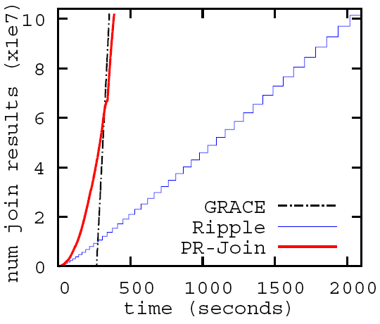
PR-Join leveraging SSD
Near-optimal total I/O cost
Higher early result rate
Setting: 10GB joins 10GB, 500MB memory
Inputs on HD; SSD for temp storage
Notes:
Analytical bounds on result rate prove advantage of PR-Join over prior approaches.

Slide 46
Concurrent Queries & Updates in Data Warehouse
Data Warehouse queries dominated by table scans
Sequential scan on HD
Updates are delayed to avoid interfering
E.g., Mixing random updates with TPCH queries would incur 2.9X query slowdown
Thus, queries are on stale data

Slide 47
Concurrent Queries & Updates in Data Warehouse
Our Approach: Cache updates on SSD
Queries take updates into account on-the-fly
Updates periodically migrated to HD in batch
Improves query latency by 2X, improves update throughput by 70X
Data Warehouse
2. Query processing
1. Incoming updates
Table (range) scan
Related updates
Merge
3. Migrate updates
SSD (updates)
Disks (main data)
[Sigmod’11]
Notes:
Under submission

Slide 48
Hi-Spade: Outline / Key Take-aways
Hierarchies are important but challenging
Hi-Spade vision: Hierarchy-savvy algorithms & systems
Smart thread schedulers enable simple, hierarchy-savvy abstractions
Flash-savvy (database) systems maximize benefits of Flash devices
Ongoing work w/ many open problems

Slide 49
Many Open Problems
Hierarchy-savvy ideal: Simplified view + thread scheduler that will rule the world
New tools & architectural features that will help
Extend beyond MP platform to cluster/cloud
Hierarchy-savvy scheduling for power savings
Tension between abstractions & memory technology quirks
PCM-savvy systems: How will Phase Change Memory change the world?

Slide 50
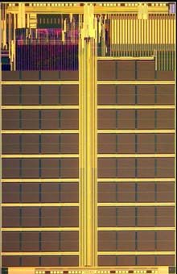
Rethinking Database Algorithms for Phase Change Memory
PCM is a promising byte-addressable non-volatile memory technology
Expected to replace DRAM as future main memory
PCM-DB: database systems exploiting PCM as primary main memory
New goal: minimize PCM writes
Writes use 6X more energy than reads
Writes 20X slower than reads, lower BW, wear-out
Three analytical metrics
PCM-friendly B⁺-tree and hash joins
[CIDR’11]

Slide 51
B⁺-Tree Index
Node size 8 cache lines; 50 million entries, 75% full;
Three workloads: Inserting / Deleting / Searching 500K random keys
PTLSSim extended with PCM support
Total wear
Energy
Execution time
Unsorted leaf schemes achieve the best performance
For insert intensive: unsorted-leaf
For insert & delete intensive: unsorted-leaf with bitmap

Slide 52
Hi-Spade: Key Take-aways
Hierarchies are important but challenging
Hi-Spade vision: Hierarchy-savvy algorithms & systems
Smart thread schedulers enable simple, hierarchy-savvy abstractions
Flash-savvy (database) systems maximize benefits of Flash devices
Ongoing work w/ many open problems

Slide 53
Hi-Spade Collaborators
Intel Labs Pittsburgh: Shimin Chen (co-PI)
Carnegie Mellon: Guy Blelloch, Jeremy Fineman, Julian Shun, Harsha V. Simhadri, Kanat Tangwongsan, Sushanth Tiruvaipati
EPFL: Anastasia Ailamaki, Manos Athanassoulis, Radu Stoica
Microsoft Research: Suman Nath
Past:
Intel Labs: Limor Fix, Michael Kozuch, Chris Wilkerson
CMU: Babak Falsafi, Nikos Hardavellas, Robert Harper, Ryan Johnson, Vasilis Liaskovitis, Todd Mowry, Ippokratis Pandis, Daniel Spoonhower
U.T. Austin: Rezaul Chowdhury, Vijaya Ramachandran

